Slide 1
Cloud Scale Machine Learning
Understanding Azure Machine Learning service

Slide 2
Preamble – The Agenda
An Overview of Machine Learning
Lab – Hands on with scikit-learn and TensorFlow
Understanding Azure Machine Learning service
Lab – Your First Machine Learning Experiment in the Cloud
Advanced Experimentation Techniques in Azure Machine Learning service
Lab – Hands-on Advanced Experimentation in Azure Machine Learning service
The Intersection of Data Science and DevOps
Lab – Automating your Machine Learning Pipeline in the Cloud

Slide 3
Preamble – The Agenda
An Overview of Machine Learning
Lab – Hands on with scikit-learn and TensorFlow
Understanding Azure Machine Learning service
Lab – Your First Machine Learning Experiment in the Cloud
Advanced Experimentation Techniques in Azure Machine Learning service
Lab – Hands-on Advanced Experimentation in Azure Machine Learning service
The Intersection of Data Science and DevOps
Lab – Automating your Machine Learning Pipeline in the Cloud

Slide 4
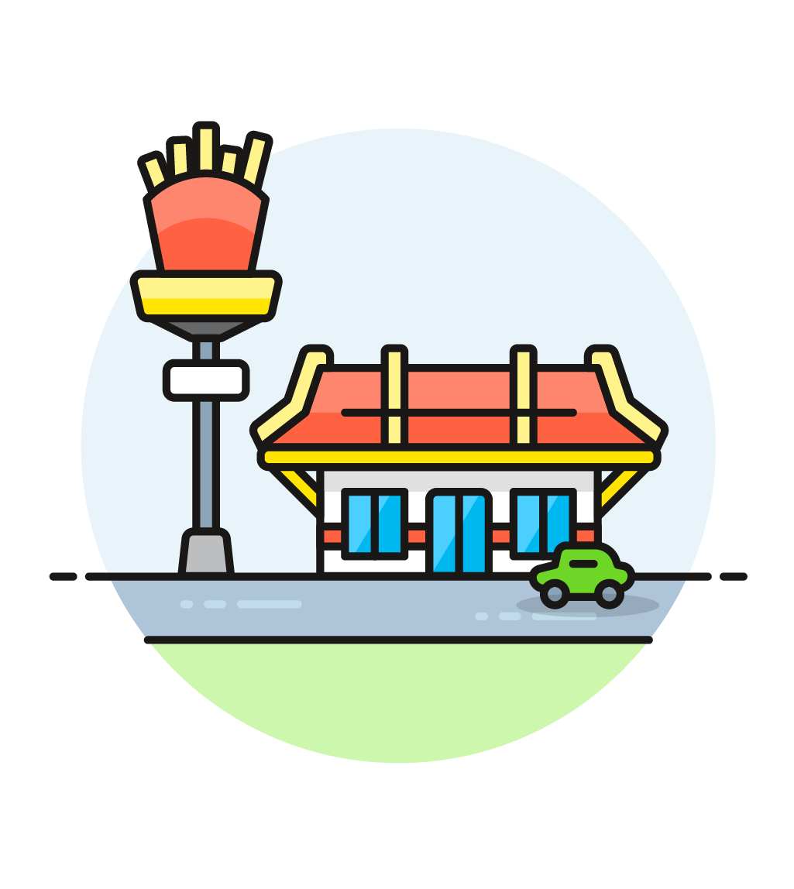

Preamble – Some Initial Thoughts

Slide 5

Preamble – Some Initial Thoughts
https://github.com/cloudscaleml/

Slide 6
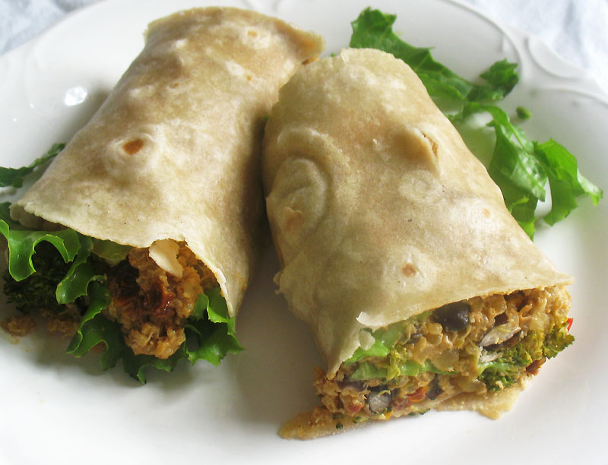

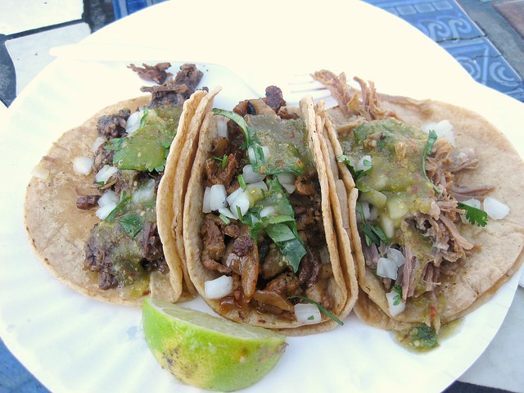
Preamble – What are we making?
burrito
tacos

Slide 7


Slide 8
programming
algorithm
answer
input
Notes:
In traditional programming, we generally think of the process as designing and implementing an algorithm which, when given an appropriate input, will produce the answer we are looking for.

Slide 9
machine learning
answer
algorithm
input
Notes:
But machine learning is different.
Here, we provide some inputs (data), along with the answers (labels) we are looking to get from each input.
For example, each input might be an image, and each answer is the name of the object we want to detect in the image.
In our case, each input is an image of handwritten digit, and the answer is the actual digit it represents.
The machine learning process automatically generates an algorithm for us, from the inputs and the associated answers we provide. We can then use that algorithm to provide answers for new inputs we haven’t seen yet.

Slide 10
machine learning
science-y
things
model
data
Notes:
In machine learning circles, that algorithm is called a model, and the inputs and answers are collectively referred to as data. Typically, we need a *lot* of data – and the more complex the task, the more data we need.
You’ve probably heard about the various “science-y” things that can be used to build these models: things live boosted trees and convolutional neural networks. You’ve probably also head to the tools that people use to run them, like scikit-learn and PyTorch and Tensorflow. We’re not going to get into the details of how they work in this session, but for now the important thing to take away is that we start with a lot of data, use a computational framework (and a lot of CPU or GPU-hours) to analyze the data, and the output is a model we will use to generate predictions.

Slide 11
science
Notes:
This is the idealized process.

Slide 12
science
Notes:
This is what actually happens: the “loop of pain”, when we discover our assumptions were wrong, or the data was inadequate, or that we needed to solve a different problem entirely.

Slide 13


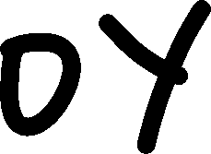

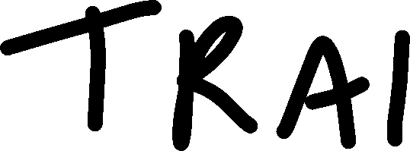
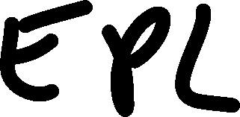

Slide 14
AI on the Cloud

Slide 15





Machine Learning on Azure
Domain specific pretrained models
To reduce time to market
…
Vision
Speech
Language
Search
Familiar Data Science tools
To simplify model development
PyCharm
Jupyter
Visual Studio Code
Command line
Popular frameworks
To build advanced deep learning solutions
Pytorch
TensorFlow
Scikit-Learn
Onnx
Productive services
To empower data science and development teams
Azure Databricks
Azure Machine Learning
Machine Learning VMs
Powerful infrastructure
To accelerate deep learning
CPU
GPU
FPGA

Slide 16


Machine Learning
Typical E2E Process
Prepare
Experiment
Deploy
…
Prepare Data
Build model (your favorite IDE)
Train & Test Model
Register and Manage Model
Build Image
Deploy Service
Monitor Model
Orchestrate

Slide 17
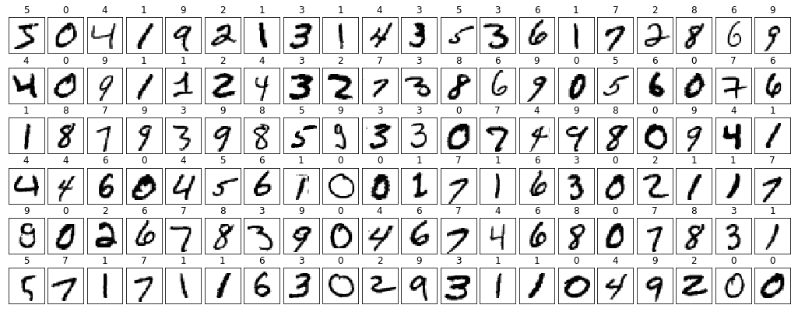
Notes:
Here are two examples of the training images we’ll be working with.
The first image is labelled as the digit “two”.
The second is labelled as the digit “one”.
TODO: Yann Lecun reference??

Slide 18
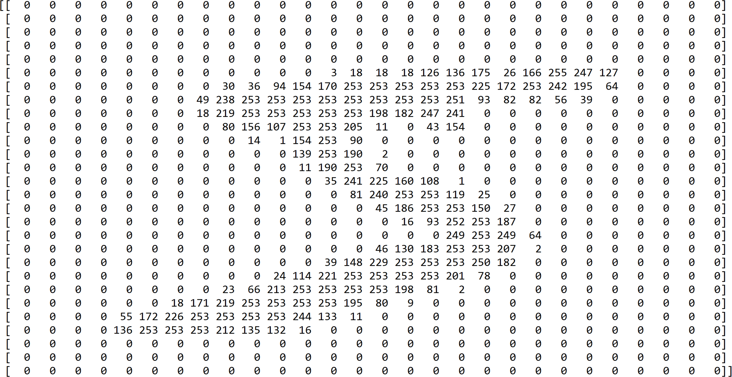

Slide 19
create model locally

Slide 20
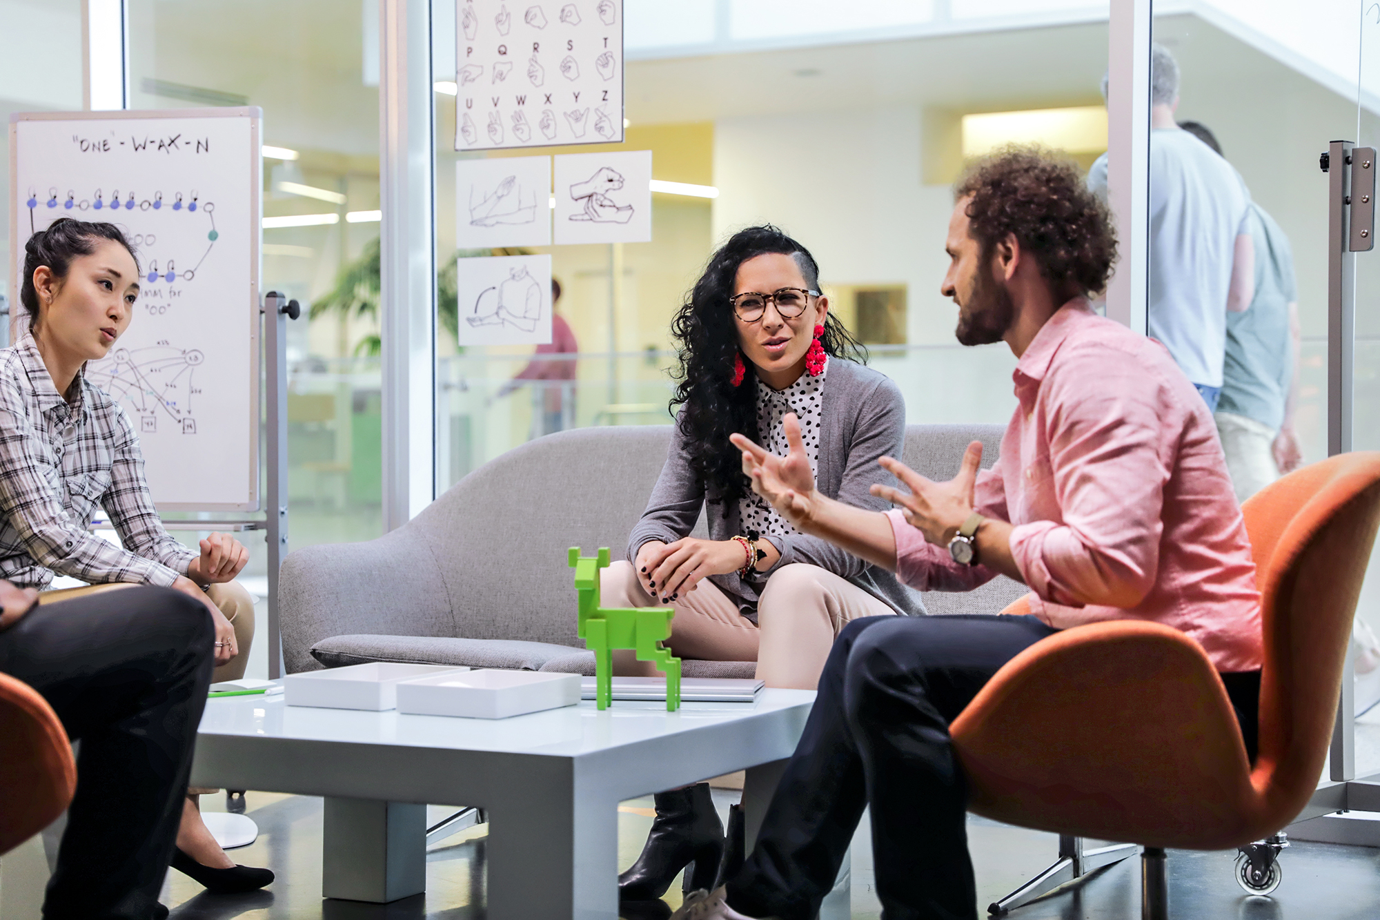
working with others
Notes:
made up story of a team

Slide 21






the team workspace - logical
Notes:
Experiments – this is where you try stuff / will have a history / track code through snapshots for every run / keep sanity (metadata)
Data Stores – where does your data live – MNIST is fine until it doesn’t fit on your hard drive, you also need to share with others, and you spilt your coffee once on your machine and lost everything
Compute – the metal where the experiments run (physical run on compute)
Models – output (just the good ones – you specify what to keep and how to version)
Images – package model with inference code and everything you need for it to run properly
Deployments – actual running models with ip addresses and everything

Slide 22




the team workspace - physical
Notes:
Compute – the actual machines where these things run (I only want these things to run when I have jobs!!)
Storage – literal azure storage account where we store: data use it like a scratch space or local drive (you can add more!! Using datastores from before – this is basically the default datastore)
Registry – where we store the images we talked about in the last slide (but also for running all of the experiments! – you can add your own – and run your experiments from there)
Key vault – storing secrets that we need to attach a compute storage, dsvm, we don’t want people to have your passwords – how would they want us to word this?
App Insights – this is for deployed models and their telemetry (you can also customize what you collect – but we won’t talk about that here)
TODO: Need to discuss issue of cost
TODO: Discuss that this is the baseline and does not include any compute resources that might be added (or external data sources)

Slide 23
workspace and compute

Slide 24

the team workspace - logical
Notes:
Experiments – this is where you try stuff / will have a history / track code through snapshots for every run / keep sanity (metadata)
Data Stores – where does your data live – MNIST is fine until it doesn’t fit on your hard drive, you also need to share with others, and you spilt your coffee once on your machine and lost everything
Compute – the metal where the experiments run (physical run on compute)
Models – output (just the good ones – you specify what to keep and how to version)
Images – package model with inference code and everything you need for it to run properly
Deployments – actual running models with ip addresses and everything

Slide 25
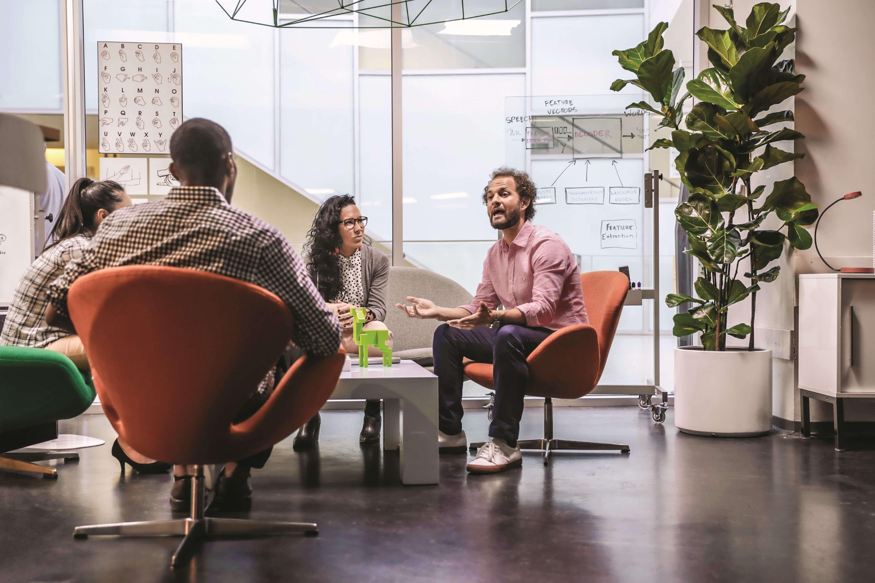
showing your work
Notes:
back to made up story (this time someone leaves the team)

Slide 26
running experiments

Slide 27

the team workspace - logical
Notes:
Experiments – this is where you try stuff / will have a history / track code through snapshots for every run / keep sanity (metadata)
Data Stores – where does your data live – MNIST is fine until it doesn’t fit on your hard drive, you also need to share with others, and you spilt your coffee once on your machine and lost everything
Compute – the metal where the experiments run (physical run on compute)
Models – output (just the good ones – you specify what to keep and how to version)
Images – package model with inference code and everything you need for it to run properly
Deployments – actual running models with ip addresses and everything

Slide 28
Azure ML
Workspace
1. Snapshot folder and
send to experiment
2. create docker image
6. Stream stdout, logs, metrics
Docker Image
5. Launch script
3. Deploy docker and snapshot to compute
6. Stream stdout, logs, metrics
7. Copy over outputs
Compute Target
4. Mount datastore to compute
Data Store
My Computer
Notes:
DANIEL slide
Explain the flow step by step

Slide 29


the team workspace - logical
Notes:
Experiments – this is where you try stuff / will have a history / track code through snapshots for every run / keep sanity (metadata)
Data Stores – where does your data live – MNIST is fine until it doesn’t fit on your hard drive, you also need to share with others, and you spilt your coffee once on your machine and lost everything
Compute – the metal where the experiments run (physical run on compute)
Models – output (just the good ones – you specify what to keep and how to version)
Images – package model with inference code and everything you need for it to run properly, (docker image)
Deployments – actual running models with ip addresses and everything

Slide 30
models
Notes:
Use following slides as a recap of the demo you just did.

Slide 31
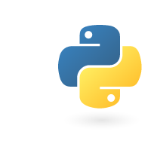
Create images
+
Scoring file.py
+
Python Environment

Slide 32
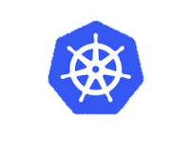
Deploy image
+
Scoring file.py
+
Python Environment
+
Azure Kubernetes Service (AKS)
or
Azure Container Instance

Slide 33
the team workspace - logical
Notes:
Experiments – this is where you try stuff / will have a history / track code through snapshots for every run / keep sanity (metadata)
Data Stores – where does your data live – MNIST is fine until it doesn’t fit on your hard drive, you also need to share with others, and you spilt your coffee once on your machine and lost everything
Compute – the metal where the experiments run (physical run on compute)
Models – output (just the good ones – you specify what to keep and how to version)
Images – package model with inference code and everything you need for it to run properly, (docker image)
Deployments – actual running models with ip addresses and everything

Slide 34
the team workspace - physical
Notes:
Compute – the actual machines where these things run (I only want these things to run when I have jobs!!)
Storage – literal azure storage account where we store: data use it like a scratch space or local drive (you can add more!! Using datastores from before – this is basically the default datastore)
Registry – where we store the images we talked about in the last slide (but also for running all of the experiments! – you can add your own – and run your experiments from there)
Key vault – storing secrets that we need to attach a compute storage, dsvm, we don’t want people to have your passwords – how would they want us to word this?
App Insights – this is for deployed models and their telemetry (you can also customize what you collect – but we won’t talk about that here)
TODO: Need to discuss issue of cost
TODO: Discuss that this is the baseline and does not include any compute resources that might be added (or external data sources)

Slide 35

Azure Machine Learning service
Questions?

Slide 36
Lab
Your First Machine Learning Experiment in the Cloud

Slide 37
